Slide 1
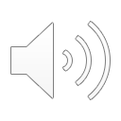
Ocean observation systems

Slide 2
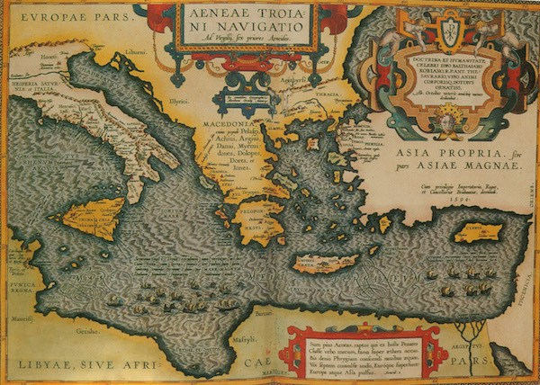
History of ocean exploration
In about 2,850 years ago (850 BC) that early naturalists and philosophers started trying to make sense of the enormous bodies of water they saw from land.
Modern oceanography began as a field of science only a little less than 130 years ago, in the late 19th century, after Americans, British and Europeans launched a few expeditions to explore ocean currents, ocean life, and the seafloor off their coastlines.
The first scientific expedition to explore the world’s oceans and seafloor was the Challenger Expedition, from 1872 to 1876, on board the British three-masted warship HMS Challenger.
But modern oceanography really took off less than 60 years ago, during World War II, when the U.S. Navy wanted to learn more about the oceans to gain fighting advantages, especially in submarine warfare.
A map of the Mediterranean Sea made in 1595 by Abraham Ortelius, a Dutch cartographer. (Courtesy of Cartographic Associates)
https://divediscover.whoi.edu/history-of-oceanography/
Notes:
Ocean exploration spans hundreds of years, if not thousands.

Slide 3
Initial ocean observations
The modern age brought with it technologies that enabled more regular, more intensive, less expensive and safer methods of exploration and exploitation.
In 1848 Matthew Fontaine Maury became the first recorded individual to systematically evaluate recorded information to create the first wind and currents map for the northern Atlantic Ocean. His aim was to make shipping between Europe and North America quicker, cheaper and safer.
In 1957 Marie Tharp created the first seafloor map of the Atlantic Ocean.
Although the principles and drivers of Ocean Observation have not changed, new technologies have enabled an explosion in the amount of data and information that are collected.
Floats, buoys and other observation platforms that are mounted with sensors and collect data, which are then turned into maps and models

Slide 4
Before satellite era
In situ: Literally means on-site observations
Few and far in between
Issues on non-uniformity in both space and time.
Buoys/Moorings
Errors in observations
http://www2.hawaii.edu/~jmaurer/sst/

Slide 5
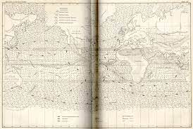
Ship drift
http://oceanmotion.org/html/gatheringdata/shipdrift.htm

Slide 6
Buoys

Slide 7
ADCP: Acoustic Doppler Current Profiler
https://www.pmel.noaa.gov/gtmba/taotriton-map

Slide 8
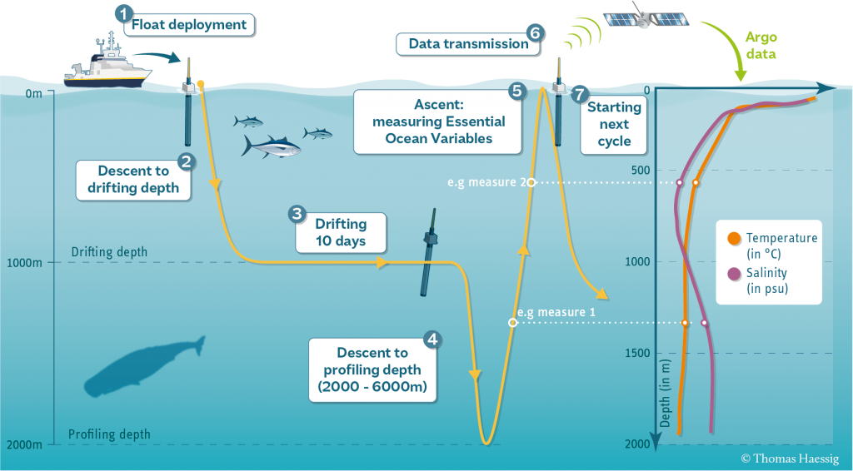
ARGO
https://argo.ucsd.edu/how-do-floats-work/

Slide 9
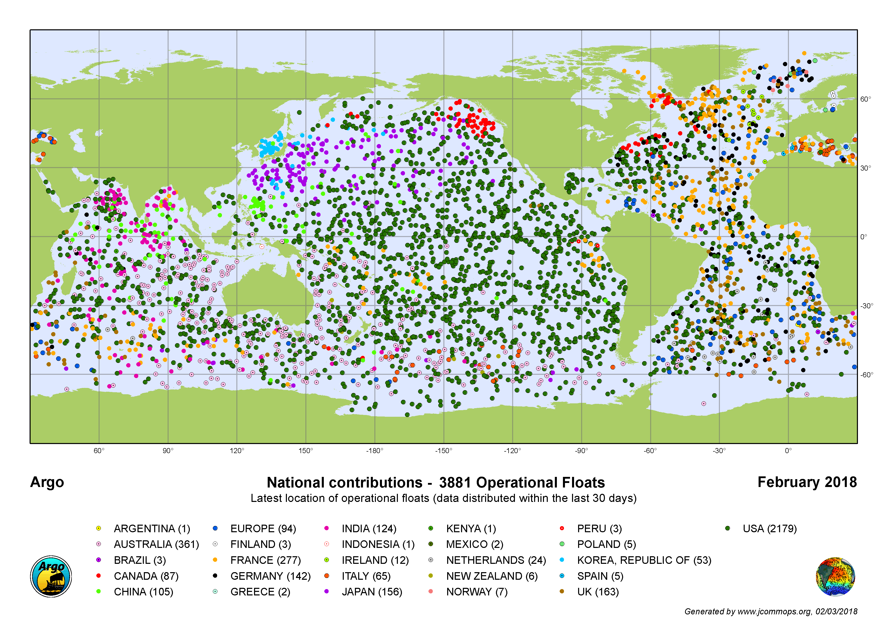

Slide 10
CTD: Conductivity, Temperature, Depth
The shipboard CTD is made up of a set of small probes attached to a large metal rosette wheel.
The rosette is lowered on a cable down to the seafloor, and scientists observe the water properties in real time via a conducting cable connecting the CTD to a computer on the ship. A remotely operated device allows the water bottles to be closed selectively as the instrument ascends.
A standard CTD cast, depending on water depth, requires two to five hours to collect a complete set of data.
Water sampling is often done at specific depths so scientists can learn the physical properties of the water column are at that particular place and time.
Small, low-powered CTD sensors are used on autonomous instruments like the moored profiler, gliders, profiling floats and AUVs .
https://www.whoi.edu/what-we-do/explore/instruments/instruments-sensors-samplers/conductivity-temperature-depth-ctd-sensors/

